Slide 1

Non-Representative Polls
Jennifer Kanjana
@jennkanjana

Slide 2

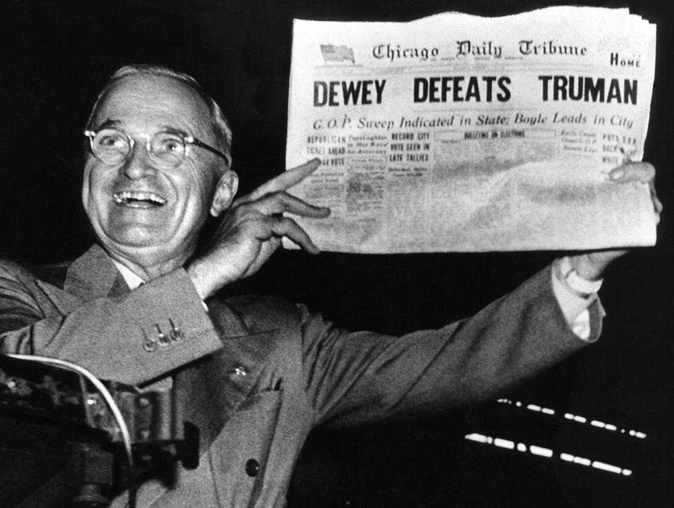
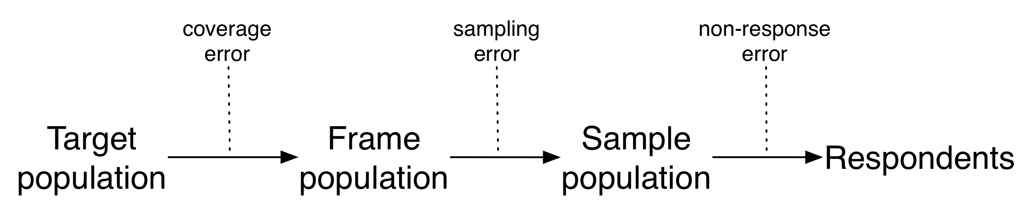

Slide 3
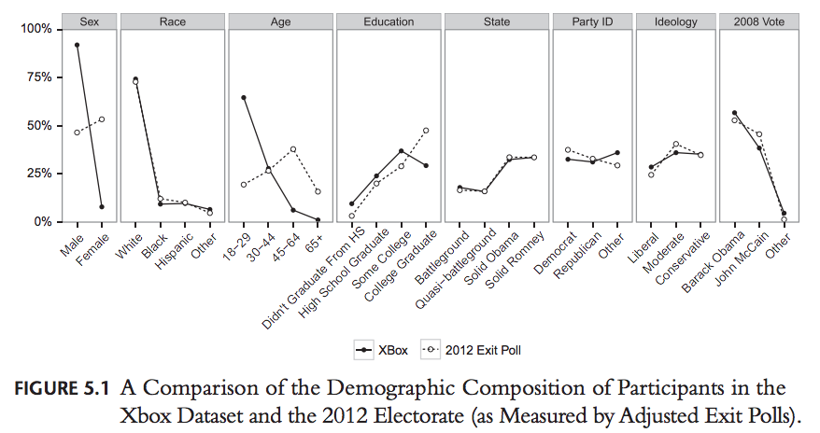

Slide 4
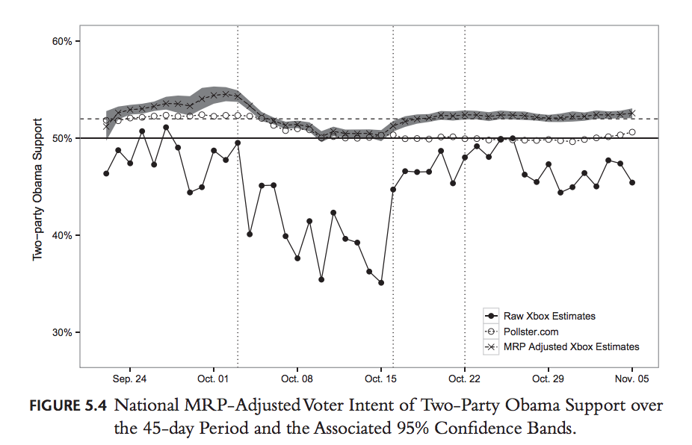

Slide 5
Sources
Salganik, M. J. (2017). Bit by bit: social research in the digital age. Princeton University Press.
Gelman, A., Goel, S., Rothschild, D., & Wang, W. (2016). High-frequency polling with non-representative data. Political Communication in Real Time: Theoretical and Applied Research Approaches, 12, 92-97.

